Slide 1
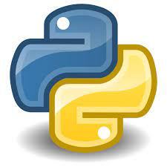


COUNTDOWN TIMER USING PYTHON
TEAM 2
GURU PRASATH C

Slide 2


APROACH
Step 1: Import the time module.
Step 2: Then ask the user to input the length of the countdown in seconds.
Step 3: This value is sent as a parameter ‘t’ to the user-defined function countdown(). Any variable read using the input function is a string. So, convert this parameter to ‘int’ as it is of string type.
Step 4: In this function, a while loop runs until time becomes 0.
Step 5: Use divmod() to calculate the number of minutes and seconds. You can read more about it here.

Slide 3
Step 5: Use divmod() to calculate the number of minutes and seconds. You can read more about it here.
Step 6: Now print the minutes and seconds on the screen using the variable timeformat.
Step 7: Using end = ‘\r’ we force the cursor to go back to the start of the screen (carriage return) so that the next line printed will overwrite the previous one.
Step 8: The time.sleep() is used to make the code wait for one sec.
Step 9: Now decrement time so that the while loop can converge.
Step 10: After the completion of the loop, we will print “Fire in the hole” to signify the end of the countdown.

Slide 4
SOURCE CODE EXPLAINATION
1
Using library module “TIME”
Below function is used to display the countdown using “time” module
def countdown(t):
while t:
mins, secs = divmod(t, 60)
timer = '{:02d}:{:02d}'.format(mins, secs)
print(timer, end="\r")
time.sleep(1)
t -= 1

Slide 5
# import the time module
import time
# define the countdown func.
def countdown(t):
while t:
mins, secs = divmod(t, 60)
timer = '{:02d}:{:02d}'.format(mins, secs)
print(timer, end="\r")
time.sleep(1)
t -= 1
print('Fire in the mountain!!')
# input time in seconds
t = input("Enter the time in seconds: ")
# function call
countdown(int(t))
SOURCE CODE

Slide 6
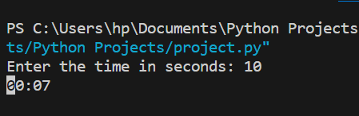
OUTPUT

Slide 7



THANK YOU!!

